Slide 1
CS 513
Knowledge Discovery and Data Mining
Risk Factor Classification

Slide 2
Team Members
Abhishek Desai
CWID: 10464843
Dhruveel Doshi
CWID: 10459460
Raj Shah
CWID: 10469735
Sacheth Shetty
CWID: 10459184

Slide 3
Problem Statement
Classification of the risk factor of vehicle insurance products which include different 7 coverage options.
Vehicle insurance products usually have 7 different types of coverage options namely: auto liability coverage, uninsured, underinsured motorist coverage, comprehensive coverage, collision coverage, medical payments coverage and personal injury protection.
Analysing the risk factor to the insurance companies by classifying car_value, risk_factor, C_previous, duration_previous, etc.
By using classification modelling we are trying to classify the insurance that has been sold on the basis of risk factor which ranges from 1-4, where 1 is “low risk” and 4 is “high risk”.
https://www.kaggle.com/akhilups/insurance-product-purchase-prediction

Slide 4
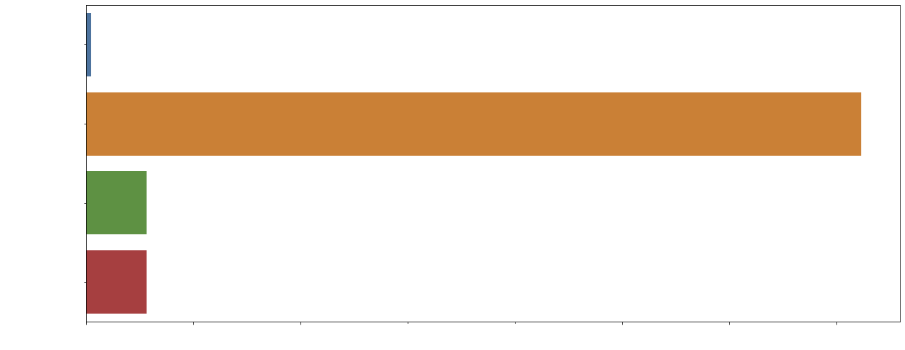
Percentage of missing values in the data set
We noted that the complete data set contained a huge number missing values in risk factor column (more that 35%). We further noted that these missing values for risk factor were directly related to Customer ID. Therefore we have taken a subset of the data which has the relevant Customer ID and risk factor values to train our model.

Slide 5
How we handled the missing values
We replaced the missing data in the columns car_value, C_previous and duration_previous with the respective mode value for the column. We used mode since the data present in these fields are categorical.

Slide 6
Data set explanation
Our data set has 24 columns and 424,831 rows of data.
The training data contain historical data which include details of the customers that ended up purchasing a car insurance policy for their vehicle as well as information about the details of their vehicles.
The task is to predict the risk factor i.e. is the the risk of the company getting a claim on the insurance and then needing to settle it, based on the car’s value, car age and other various factors.
Columns with categorical values: state, location, car value, car age, etc.

Slide 7
Data Preprocessing
Replaced the categorical values in the columns “state”, “location” and “car_value” with numerical values by encoding.
Dropped the column “time” as “time” having no actual impact on risk factor prediction and hence was removed.
Normalized the preprocessed data because the data set needed to be normalized for algorithms such as KNN and Naive Bayes because we have a huge number of values ranging from 0 - 922.

Slide 8
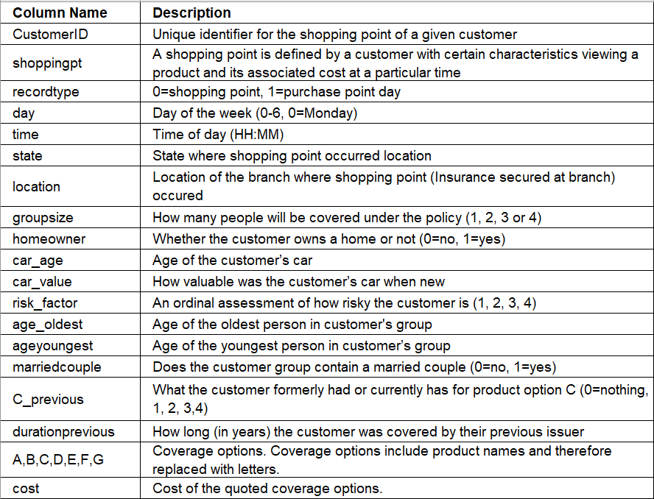
Data Fields

Slide 9
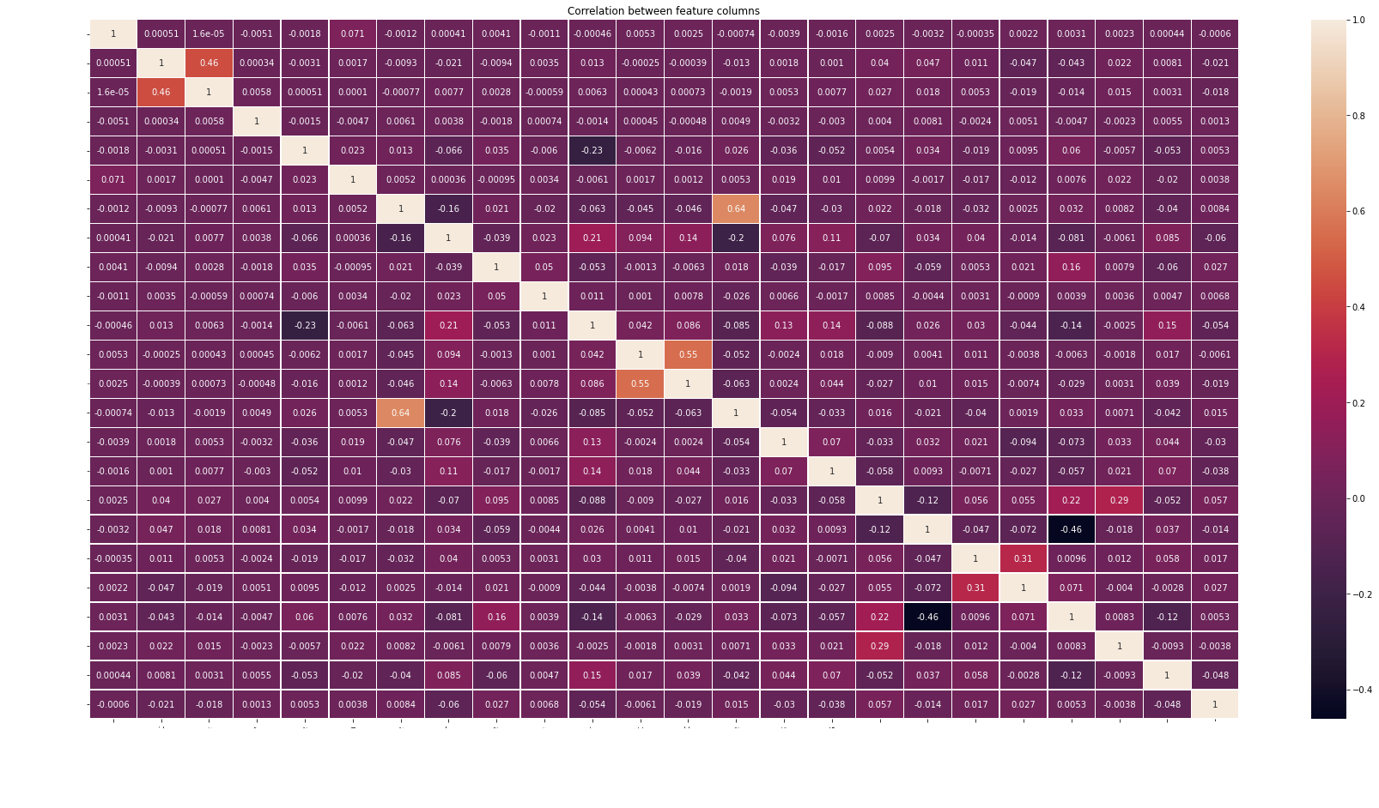
Heatmap and feature importance graphs and how they are co-related

Slide 10
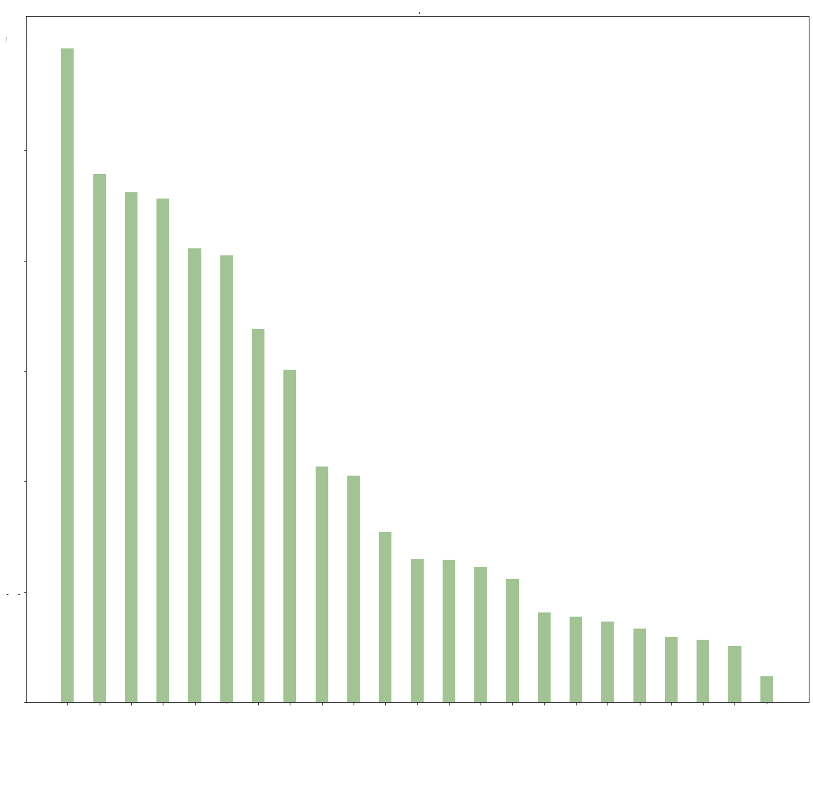
Feature Importance Graph
Feature importance refers to techniques that assign a score to input features based on how useful they are at classifying our target variable. We noted that in the dataset, “car_value” is the most dominating feature with respect to our target variable “risk_factor”.

Slide 11
Classification Algorithms
K - Nearest Neighbour
Multinomial Naive Bayes
Random Forest Classifier
Decision Tree
Gaussian Naive Bayes
Bagging Classifier
XGBoost

Slide 12
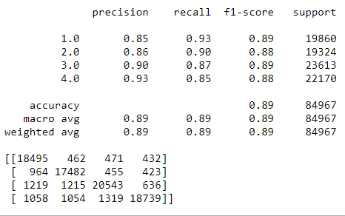
K-Nearest Neighbour
K-nearest neighbors is a simple algorithm that stores all available cases and classifies new cases based on a similarity measure in this case distance between closely grouped points.

Slide 13
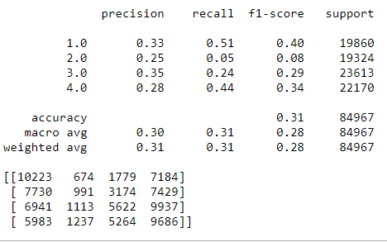
Multinomial Naive Bayes
The multinomial Naive Bayes classifier is suitable for classification with discrete features (e.g., word counts for text classification). The multinomial distribution normally requires integer feature counts.

Slide 14
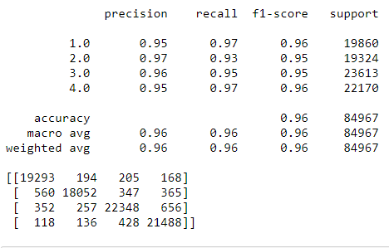
Random Forest Classifier
The random forest is a classification algorithm consisting of many decisions trees. It uses bagging and feature randomness when building each individual tree to try to create an uncorrelated forest of trees whose prediction by committee is more accurate than that of any individual tree.

Slide 15
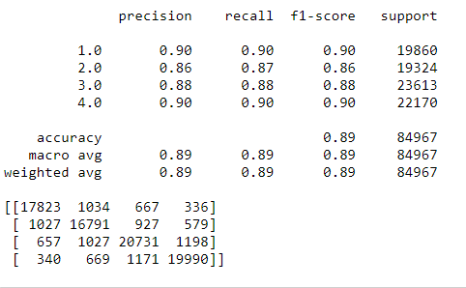
Decision Tree
The goal of using a Decision Tree is to create a training model that can use to predict the class or value of the target variable by learning simple decision rules inferred from prior data(training data).

Slide 16
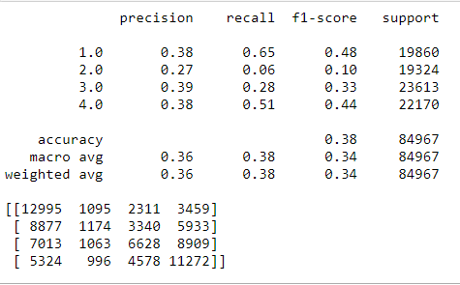
Gaussian Naive Bayes
Gaussian Naive Bayes is a classification technique based on Bayes’ Theorem with an assumption of independence among predictors. In simple terms, a Naive Bayes classifier assumes that the presence of a particular feature in a class is unrelated to the presence of any other feature.

Slide 17
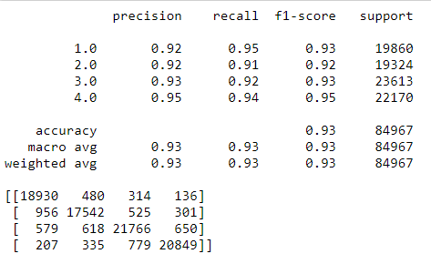
Bagging Classifier
A Bagging classifier is an ensemble meta-estimator that fits base classifiers each on random subsets of the original dataset and then aggregate their individual predictions (either by voting or by averaging) to form a final prediction

Slide 18
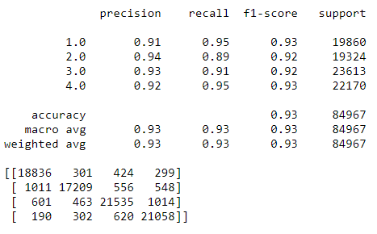
XGBoost
XGBoost is a decision-tree based ensemble Machine Learning algorithm that uses a gradient boosting framework.

Slide 19
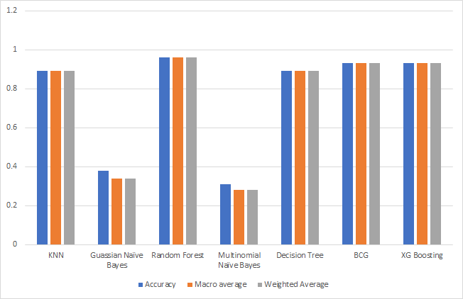
Comparison of Accuracy

Slide 20
Conclusion
Random Forest performed the best out of all the other algorithms with the highest accuracy.
Classifying the risk factor for specific insurance products helps insurance companies to identify customers who are more liable to send them an insurance claim for damage or maintenance thus helping them analyse and calculate the premium for each customer accordingly.

